Slide 1
AI CONTENT GENERATOR: AN OVERVIEW
AI-generated text production is becoming increasingly important in many industries, and it has already brought about dramatic changes in the ways we write texts and generate content.
Enabling computer systems to understand and generate natural language has been an up-and-coming field of research.
Latest advancements in Natural Language Processing (NLP) have made headway progress in facilitating this, like the GPT-3 language prediction model created by OpenAI. Given the capacity of the GPT-3 model, this study capitalizes on how the model can be used to generate and transform content without manual help from humans –
How well plausibly GPT3-authored text most nearly passes as human-like prompts for content generation and manipulation purposes.

Slide 2
Problem statement
AI content generators can help to save you time and energy, as they can quickly create content that is high-quality, engaging, and tailored to your specific needs. With AI content generators, you can create content that is optimized for search engine rankings, as well as content that is engaging and relevant to your target audience.

Slide 3
Objective
To produce high-quality, unique, and original content at a high speed.
To enable content creators to focus on other tasks, such as editing and formatting, instead of content generation.
To reduce costs associated with content creation and enable more content to be created in less time.
To enable users to customize their content creation process to suit their specific needs.objective

Slide 4
TECHNOLOGY USED:
LANGUAGE USED: PYTHON, HTML
LANGUAGE MODEL USED: Generative Pretrained transformer 3(gpt-3)
openAI platform
Platform used for implementation: VScode

Slide 5
Dataset used :
Datasets | Quantity (Tokens) | Weight in Training Mix | Epochs elapsed when training for 300 BN tokens
Common Crawl (filtered) | 410 BN | 60% | 0.44
WebText2 | 19 BN | 22% | 2.90
Books1 | 12 BN | 8% | 1.90
Books2 | 55 BN | 8% | 0.43
Wikipedia | 3 BN | 3% | 3.40

Slide 6
AI Content Generator with openAI GPT-3
CREATES:
Tweets+hastags
Cold email Template
Facebook Advert
Business pitch
Product description
Job description
Video descriptions

Slide 7
GPT-3
GPT-3, or the third generation Generative Pre-trained Transformer, is a neural network machine learning model trained using internet data to generate any type of text. Developed by OpenAI, it requires a small amount of input text to generate large volumes of relevant and sophisticated machine-generated text.
GPT-3's deep learning neural network is a model with over 175 billion machine learning parameters. To put things into scale, the largest trained language model before GPT-3 was Microsoft's Turing NLG model, which had 10 billion parameters. As of early 2021, GPT-3 is the largest neural network ever produced. As a result, GPT-3 is better than any prior model for producing text that is convincing enough to seem like a human could have written it.

Slide 8
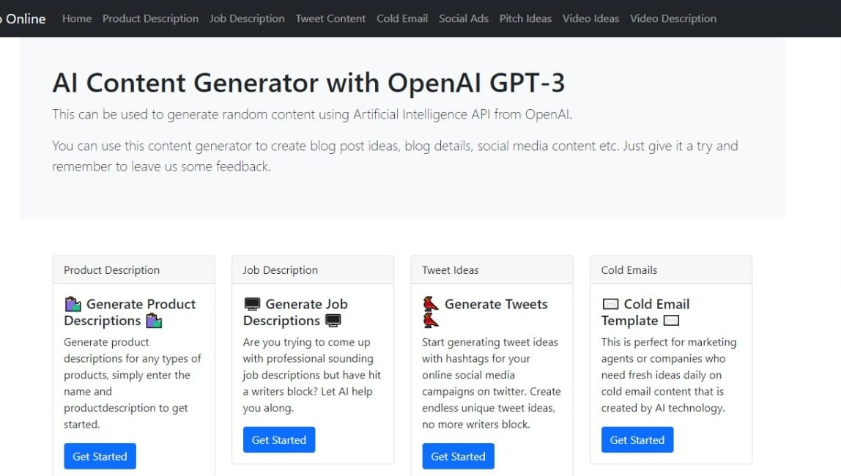

Slide 9
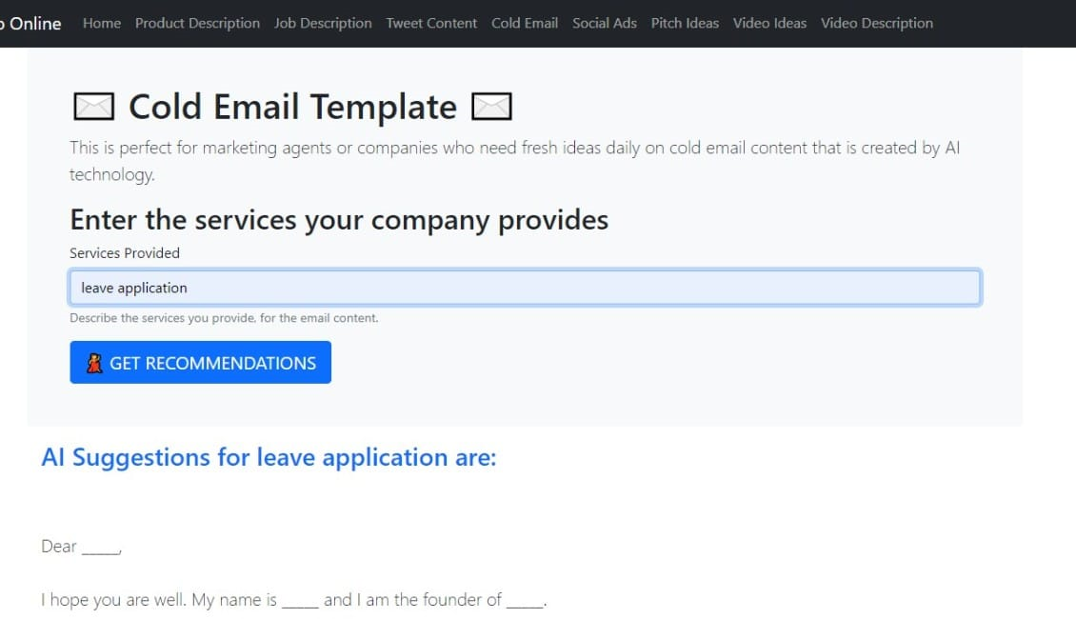

Slide 10
CONCLUSION
GPT-3 is a great example of how far AI model development has come. Even though GPT-3 doesn’t do well on everything so far and the size of it makes it difficult to be used by everyone, this is just the threshold of a lot of new improvements to come in the field of NLP!

Slide 11
THANK YOU

